Slide 1
Natural Language, Complexity, and Similarity
Prof. Sebastián Vallejo Vera

Slide 2
So far, our unit of analysis has been the token.
We have counted tokens (i.e., frequency analysis) and counted specific tokens (i.e., dictionary-based techniques).

Slide 3
This week, we will look at corpora and rather than targeting tokens (or concepts) we will:
Measure features of language
Allow comparison between texts

Slide 4
Comparing Texts

Slide 5
How would you compare these two documents?
Document 1: By the professor’s standards, the weather in Ontario during the Winter term is miserable.
Document 2: By the professor’s high standards, the weather in London during the Winter term is depressive.

Slide 6
There are different ways to compare text, depending on the unit of analysis:
Character-level comparisons
Token-level comparisons

Slide 7
Character-level comparisons
Document 1: By the professor’s standards, the weather in Ontario during the Winter term is miserable.
Document 2: By the professor’s high standards, the weather in London during the Winter term is depressive.
Longest common substring: ”The longest common substring is defined as the longest string that can be obtained by pairing characters from Document 1 and Document 2 while keeping the order of characters intact.”
Longest common substring distance: “The lcs-distance is defined as the number of unpaired characters. The distance is equivalent to the edit distance allowing only deletions and insertions, each with weight one.”

Slide 8
Character-level comparisons
Document 1: By the professor’s standards, the weather in Ontario during the Winter term is miserable.
Document 2: By the professor’s high standards, the weather in London during the Winter term is depressive.
Longest common substring: 22
Longest common substring distance:

Slide 9
Character-level comparisons
Document 1: By the professor’s standards, the weather in Ontario during the Winter term is miserable.
Document 2: By the professor’s high standards, the weather in London during the Winter term is depressive.
Longest common substring: 22
Longest common substring distance: how many characters we need to add/delete for a=b.

Slide 10
Character-level comparisons
Document 1: By the professor’s standards, the weather in Ontario during the Winter term is miserable.
Document 2: By the professor’s high standards, the weather in London during the Winter term is depressive.
The Levenshtein distance counts the number of deletions, insertions and substitutions necessary to turn b into a: 20
The Jaro distance is a number between 0 (exact match) and 1 (completely dissimilar) measuring dissimilarity between strings: 0.18

Slide 11
Ok, Sebastián, you know some names… when will I ever use this?

Slide 12
Character-level comparisons
Two main uses:
Fuzzy set matching that can also be used in…
Substantive research

Slide 13
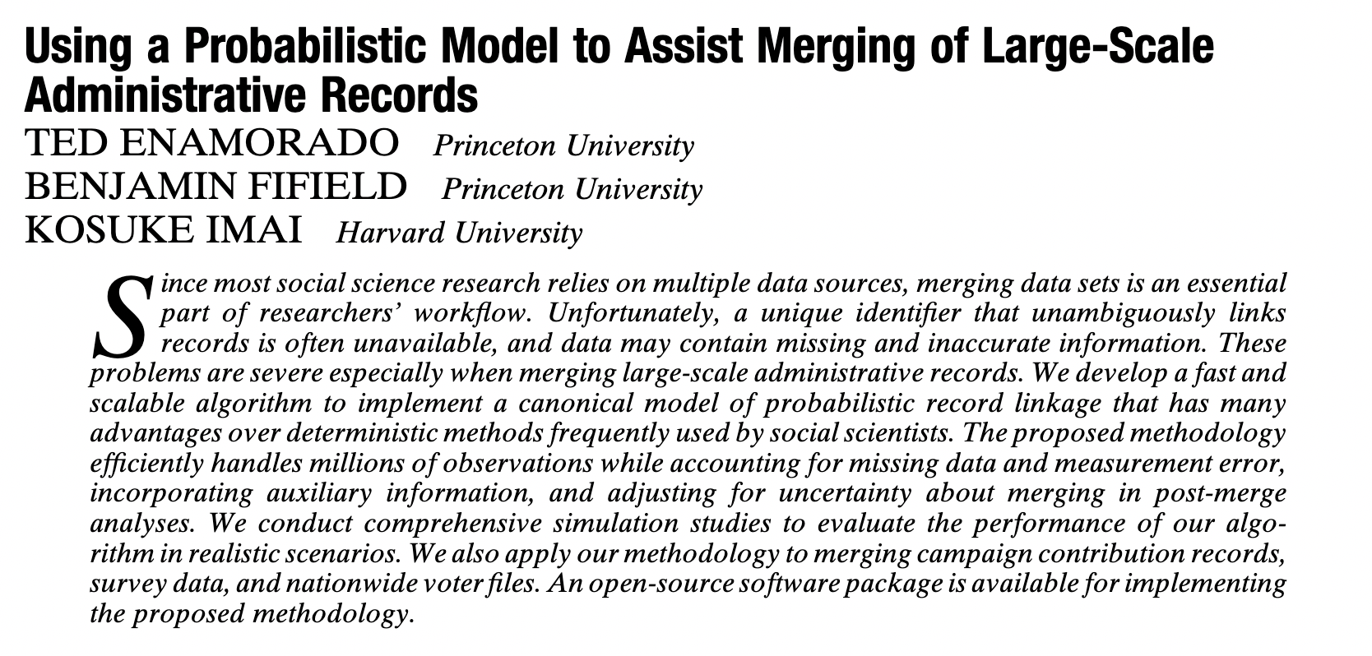

Slide 14
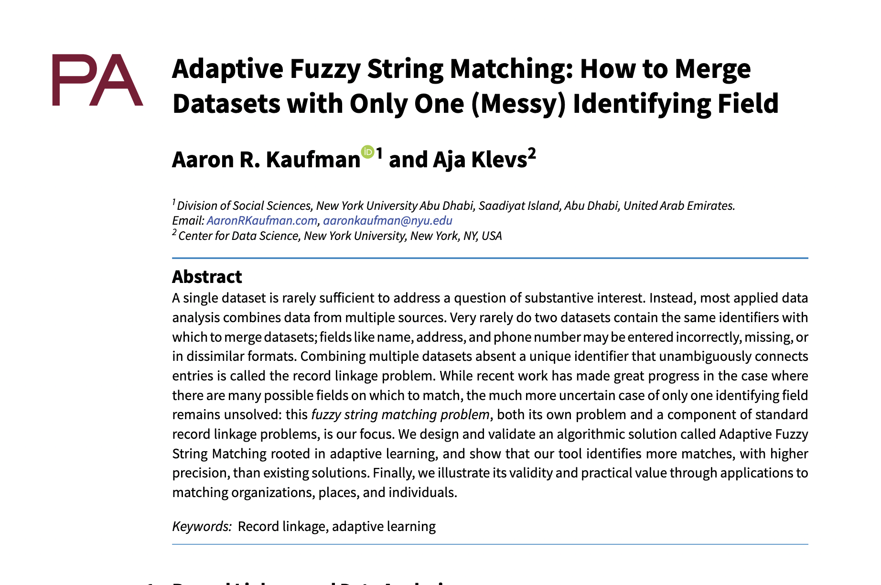

Slide 15
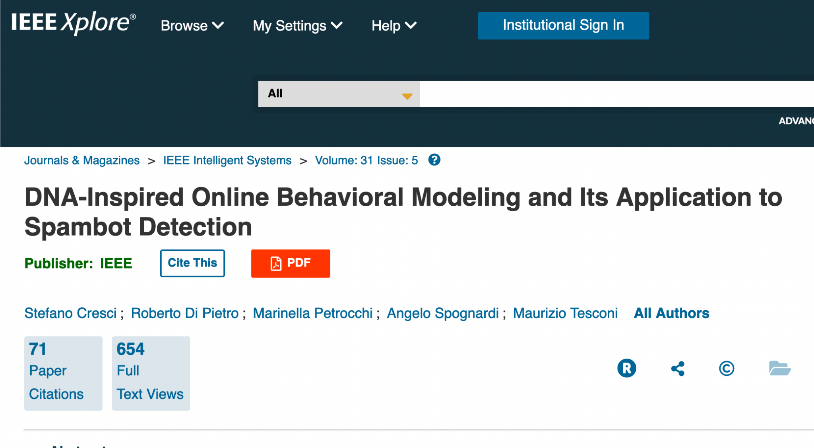

Slide 16
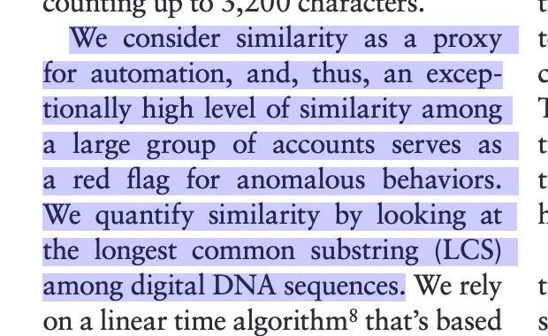

Slide 17
Token-level comparison
How similar are these three documents?
Document 1: By the professor’s standards, the weather in Ontario during the Winter term is miserable.
Document 2: By the professor’s high standards, the weather in London during the Winter term is depressive.
Document 3: The professor has strong evidence that the weather in London (Ontario) is miserable and depressive.

Slide 18
Token-level comparison
Now, we just need to find an analysis that can be systematically carried out by a computer.
Let’s think about our documents as matrices: document-feature matrices (DFM).

Slide 19
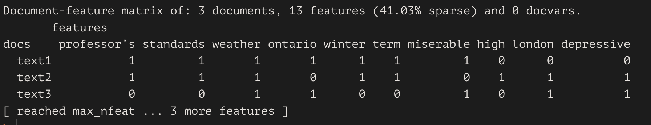
* Note how I have removed stopwords…

Slide 20
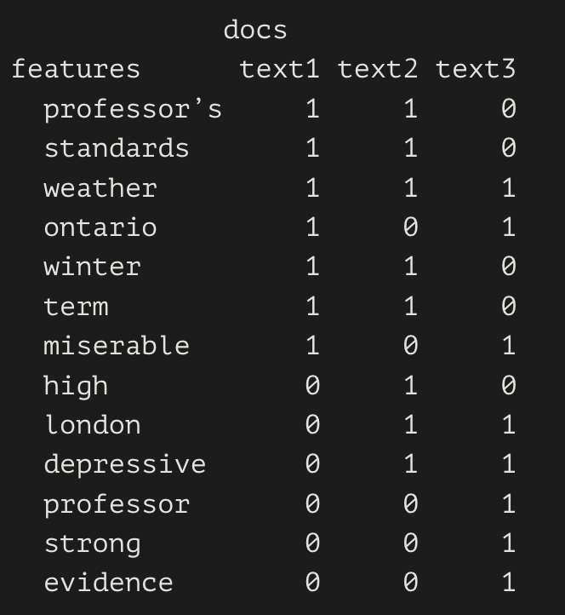
Transposed!

Slide 21
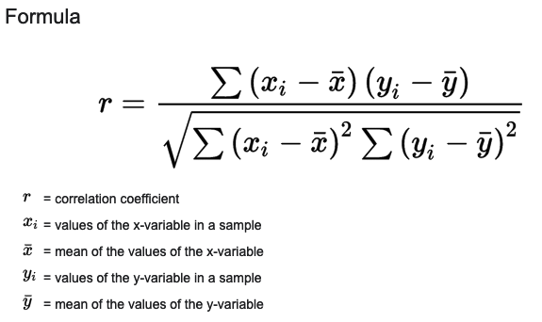
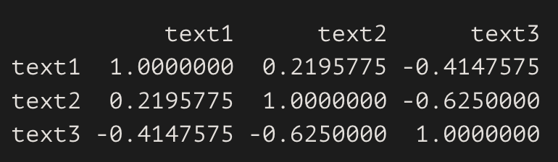
Token-level comparison
Now it is just a matter of computing a distance metric. For example:
Correlation:

Slide 22
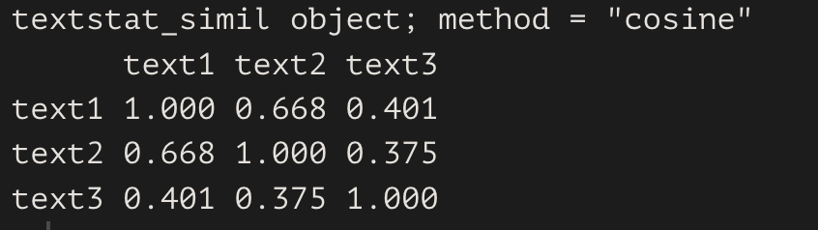
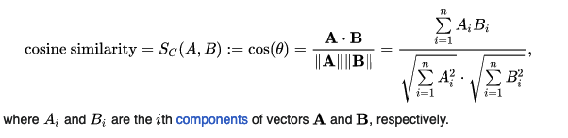


Token-level comparison
Now it is just a matter of computing a distance metric. For example:
Cosine similarity:
This is actually important for future weeks, so I made apps!!
Check the course site for this week.

Slide 23
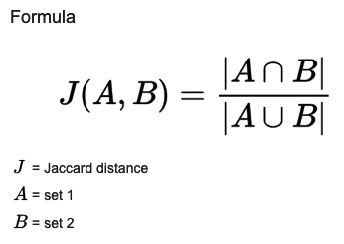
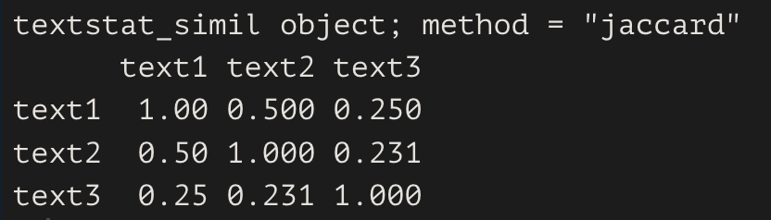
Token-level comparison
Now it is just a matter of computing a distance metric. For example:
Jaccard similarity:

Slide 24
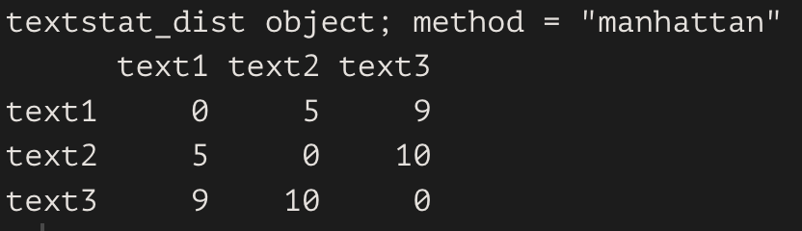
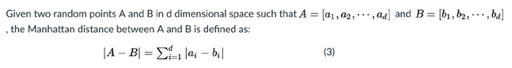
Token-level comparison
Now it is just a matter of computing a distance metric. For example:
Manhattan distance:

Slide 25
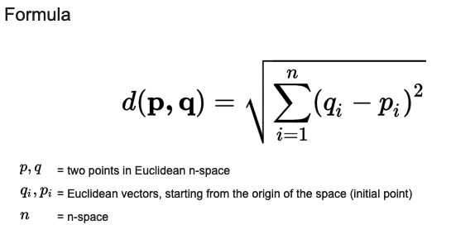
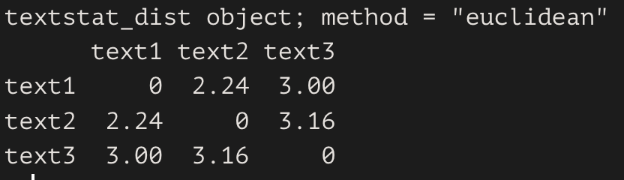
Token-level comparison
Now it is just a matter of computing a distance metric. For example:
Euclidean distance:

Slide 26
Cool, but… how can we use this?

Slide 27
Token-level comparison
A measurement of document similarity:

Slide 28
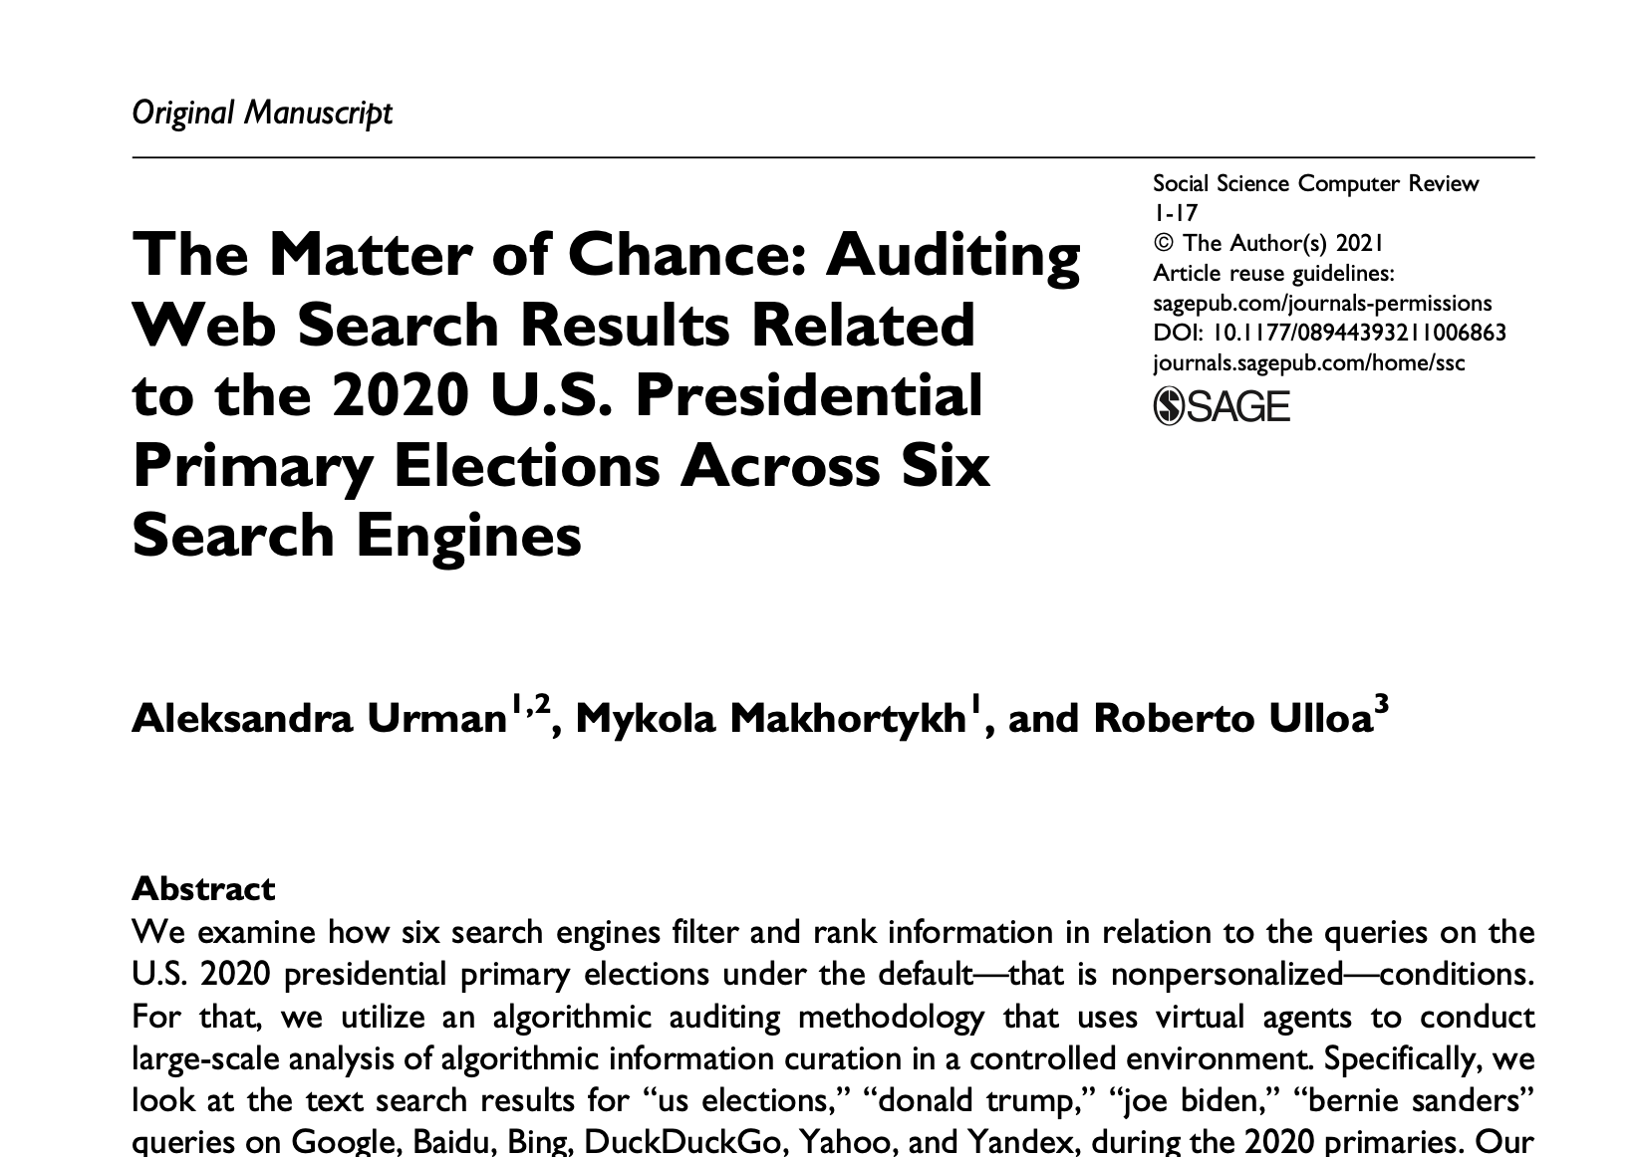

Slide 29
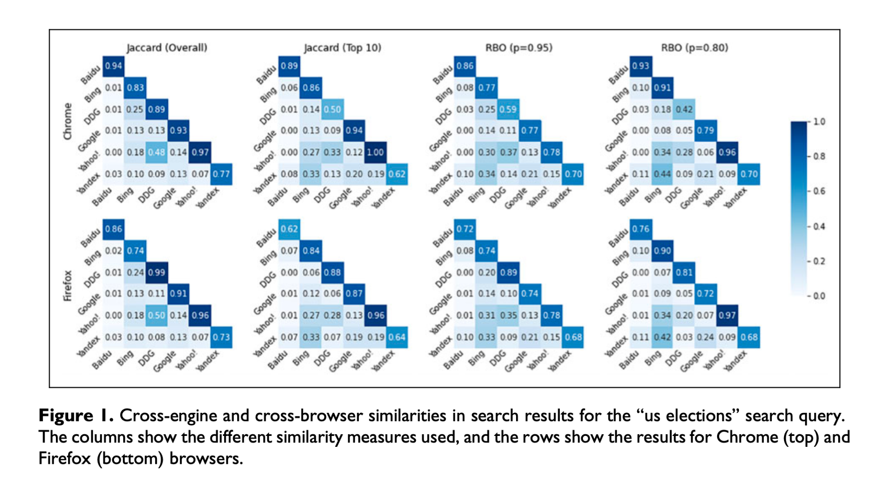

Slide 30
Token-level comparison
A measurement of document similarity.
A clustering technique:
(we will explore more of these in future weeks).

Slide 31
Complexity
Another document-level characteristic of text that we can compare is their complexity.

Slide 32
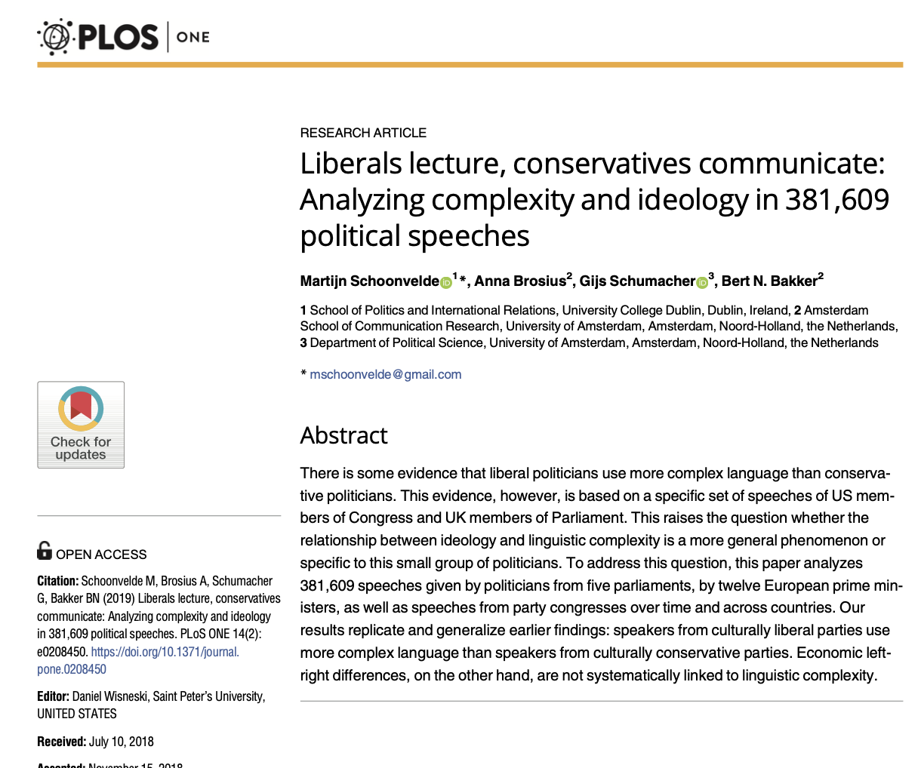

Slide 33
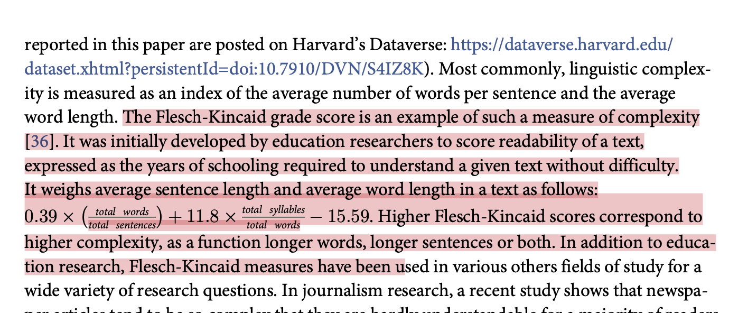

Slide 34
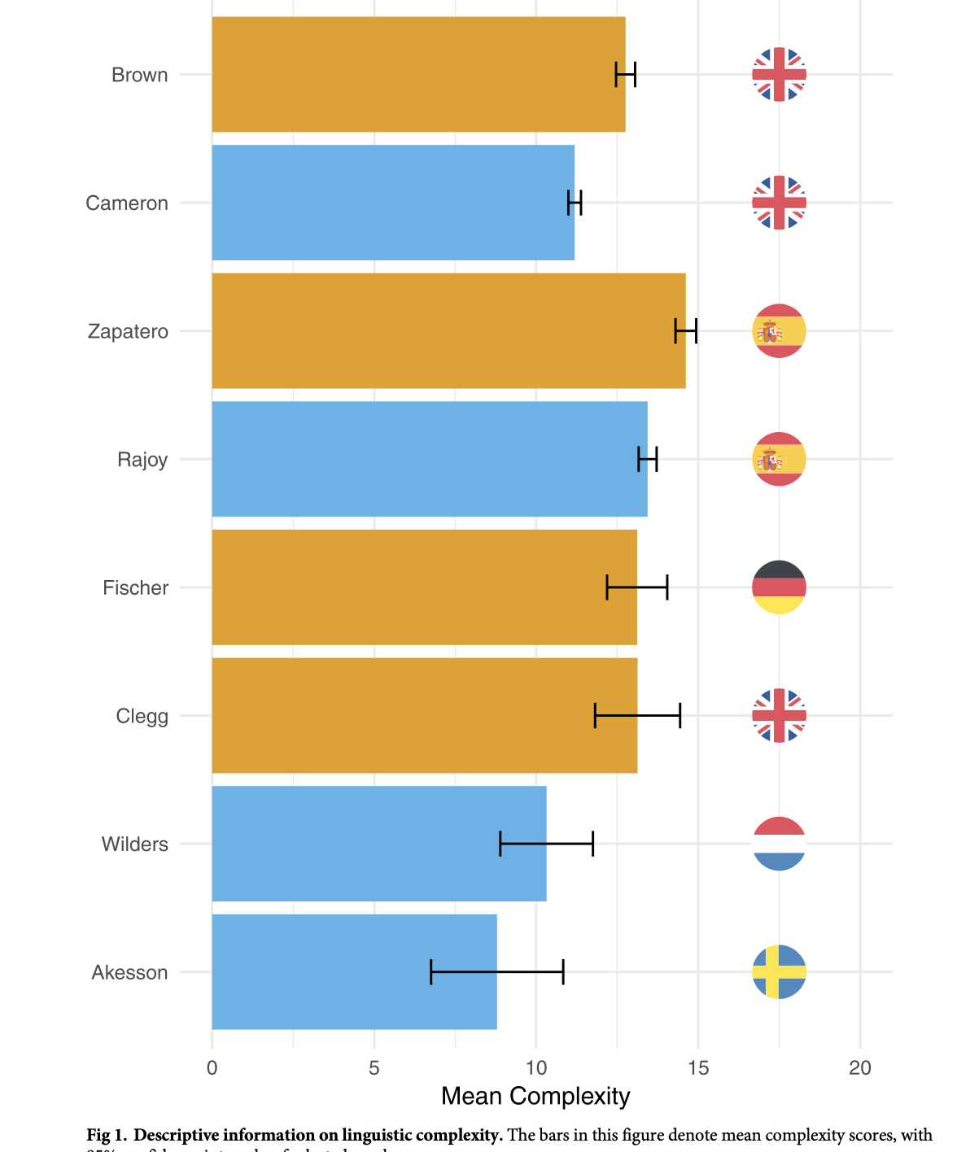

Slide 35
Any other ideas?

Slide 36
Final Considerations

Slide 37
How do we choose a similarity measure?
Cross-lingual comparison?
How can we generate consistent (temporally/spatially) measures of text characteristics (like complexity)?

